Slide 1
Advanced C++
Polymorphism (Chapter 13)
Fall 2011
Kristina Shroyer

Slide 2
Chapter Objectives
In this chapter you’ll learn:
(I concentrated on the base topics here since the book has some complexities in it – you can always read the complex parts if you would like and ask during office hours)
  What polymorphism is, how it makes programming more convenient, and how it makes systems more extensible and maintainable.
  To declare and use virtual functions to effect (implement) polymorphism.
  The distinction between abstract and concrete classes.
  To declare pure virtual functions to create abstract classes.
  How to use virtual destructors to ensure that all appropriate destructors run on an object.

Slide 3
Polymorphism - Introduction
A piece of code is said to be polymorphic if executing the code with different types of data (objects or functions) produces different types of behavior
  Example: A function would be called polymorphic if it executes differently when passed different types of parameters
  We're going to talk about how polymorphism works in relation to objects, when I talk about objects in this part I'm talking about instances of classes
Example: Animal class hierarchy (polymorphism is always associated with an inheritance hierarchy)
  Animal base class – every derived class has function move
  Maybe a program has different objects maintained as an array of Animal pointers
    So these different objects could be from any of the derived classes – since a Fish is an Animal a pointer to an Animal could point to a Fish object
    Let's say that in this program you want to loop through the array and call the move function for the specific animal each Animal pointer points too (these could be generic Animal objects, Fish objects, Frog objects, or Bird objects
      You want this program to be able to call the CORRECT move function based on the type of object (instance) the Animal pointer points to – when implemented using virtual functions polymorphism allows this to happen
      Program issues same message (move) to each animal generically
    Proper function gets called
      A Fish will move by swimming
      A Frog will move by jumping
      A Bird will move by flying
    By implementing polymorphism, each object knows how to call the proper move function based on its type (Animal, Fish, Frog, Bird)
Polymorphism:
  allows us to rely on each object in the inheritance hierarchy to do the right thing, executing the correct behavior based on it's object type
Notes:
ANIMAL – Base class (has a generic move function)
DERIVED CLASSES: Fish, Frog, Bird (all have redefined move functions) – remember from inheritance, that you can redefine an inherited function from the base class to

Slide 4
Polymorphism - Introduction
Polymorphism: executing code using different data (types of objects or functions) produces different behavior based on the type of data (object or function) that the code is executed upon
  With polymorphism, the same message sent to a variety of objects has different forms of results based on which object the message acts upon
Polymorphism promotes extensibility:
  Software written to invoke polymorphic behavior is written independently of the types of the objects to which messages are sent.
    So a pointer to a base class object will generically work on the base class object (and any derived class objects since they are base class objects) if the class is designed correctly
    Thus, new types of derived objects that can respond to existing messages can be incorporated into such a system without modifying the base system.
  Only client code that instantiates new objects must be modified to accommodate new types
    Behaviors will automatically accommodate the client based on the type of object that calls the polymorphic message (usually a function)
Important note: Code is not automatically polymorphic in C++, we're going to have to design the code to be polymorphic – we'll do this with virtual functions
Notes:
ANIMAL – Base class (has a generic move function)
DERIVED CLASSES: Fish, Frog, Bird (all have redefined move functions) – remember from inheritance, that you can redefine an inherited function from the base class to

Slide 5
Polymorphism - Introduction
Polymorphism with inheritance hierarchies – Overall Summary
  With polymorphism, one function can cause different actions to occur depending on the type of object the function is invoked on
  This allows us to “Program in the general” vs. “program in the specific”
  This allows us to process objects of classes that are part of the same hierarchy as if they are all objects of the base class (an inheritance hierarchy is needed for polymorphism)
  Each object performs the correct tasks for that object’s type
    Different actions occur depending on the type of object
  New classes can be added with little or no modification to existing code
    the only parts of a program that must be altered to accommodate new classes are those that require direct knowledge of the class you add to the hierarchy
    So back to our Animal class
      If Tortise inherits from Animal (Tortise's move function has the object move only one inch at a time), we only need to write the Tortise class and the part of the simulation that instantiates a Tortise object
        The parts of the simulation that process an Animal need little to no changes

Slide 6
Polymorphism Example
I chose this example from the book because it can also apply to GUI programming or programming with images (game programming for example)
  Think of drawing the GUI, each component (GUI object) needs to be able to draw itself in a special way, you want to be able to do this by just calling the draw() function on all the GUI components and knowing each component will execute the correct draw() function specific to that object
Example:
  Base Class: SpaceObject, contains a member function draw()
  Derived Classes: Martian, SpaceShip, LaserBeam
    each of these classes redefine the draw() function from the base class because each instance of the various class types must be drawn differently
  A space game that uses these classes might have a screen manager program to control when things draw
    This screen manager program would have some sort of container (an array or another container type) that holds SpaceObject pointers to the various objects of the various derived classes
    To refresh the screen the screen manager will iterate through the container of pointers to objects and execute the draw() function on each pointer in the container, polymorphism will allow teach type of object to respond in the correct way by calling the correct draw() function based on its type
  New derived classes can easily be added to the hierarchy without needing to make significant changes to the screen manager program
    If we wanted to add the derived class Mercurian (alien from Mercury) to the hierarchy:
      Just build a class Mercurian that inherits from SpaceObject and redefine the draw() function
    The screen manager doesn't care since it's container has pointers to all SpaceObject objects, so just add a pointer and the screen manager code will work with no modifications

Slide 7
Tools of Polymorphism
Polymorphism has two underlying technologies:
  virtual functions
  dynamic binding
    This is basically the underlying process that allows virtual functions to do their job correctly
  Remember code is not automatically polymorphic in C++, we must define it to be that way – we'll do this with virtual functions
Virtual functions allow the most specific version of a member function in an inheritance hierarchy to be selected for execution.
  Virtual functions are what makes polymorphism possible
With virtual functions and polymorphism, you can deal in generalities and let the execution-time environment concern itself with the specifics.
  You can direct a variety of objects to behave in manners appropriate to those objects without even knowing their types
    as long as those objects belong to the same inheritance hierarchy and are being accessed off a common base-class pointer

Slide 8
Relationships Among Objects in Inheritance Hierarchies
Before we look at polymorphism in detail and see how to implement it we need to look more closely at the relationships among objects in inheritance hierarchies
Concept: Objects of a derived class can be used whenever objects of a base class are expected –so if a function has a base class object as a parameter you could pass a derived class object to the function
KEY: An object of a derived class can be treated as an object of a base class
  Polymorphism is based on this idea
Certain type compatibility relationships hold among different classes in an inheritance hierarchy
  Objects in an inheritance hierarchy are often accessed through pointers
    Base class pointers can as usual point to base class objects and derived class pointers can point to derived class objects
  These are the additional rules in terms of pointers:
    A derived class object can always be assigned to a base class pointer
      Meaning base class pointers can point to derived class objects (this is the KEY)
    The opposite is not true, a derived class pointer cannot point to a base class object unless a type cast is done
      (this makes sense since a derived class object IS a base class object BUT base class object is NOT an derived class object)

Slide 9
Pointers (handles) and Inheritance Hierarchies
Key concept: An object of a derived class can be treated as an object of its base class (As we go through the examples keep this in mind)
We're going to see the following holds true:
  If we aim a base-class pointer at a base-class object
    Meaning we have a base class pointer contain the address of a base class object
    When we use the pointer to access member functions of the object it points to we:
      Invoke base-class functionality (this is natural and makes sense)
  If we aim a derived-class pointer at a derived-class object
    Meaning we have a derived class pointer contain the address of a derived class object
    When we use the pointer to access member functions of the object it points to we:
      Invoke derived-class functionality
  If we aim a base-class pointer at a derived-class object
    Meaning we have a base class pointer contain the address of a derived class object
    We can do this because a derived-class object is an object of base class
    When we use the pointer to access member functions of the object it points to we:
      Invoke base-class functionality (unless we do something special - virtual)
        Invoked functionality depends on type of the handle used to invoke the function, not type of the object to which the handle points - HANDLE Def: (the pointer or reference type) used to invoke (call) the function
        So this is NOT polymorphic, to be polymorphic the functionality would vary depending on the object that called it
    virtual functions
      Make it possible to invoke the object type’s functionality, rather than invoke the handle type’s functionality
      Crucial to implementing polymorphic behavior
Notes:
Animal a;
Animal *animalPtr;
animalPtr = &a;
Frog f;
Frog *frogPtr;
frogPtr = &f;
3. Animal a;
Animal *animalPtr;
Frog f;
animalPtr = &f;

Slide 10
Relationships Among Objects in Inheritance Hierarchies
In Chapter 12 our examples manipulated objects of the CommissionEmployee and BasePlusCommissionEmployee classes by using the object's names to invoke their member functions.
  CommissionEmployee was the base class and BasePlusCommissionEmployee was the derived class
    A BasePlusCommissionEmployee is a CommissionEmployee that also gets a base salary
  We're now going to examine these new pointer relationships between derived and base classes using this same example
    So we'll create base class pointers that point to base class objects, derived class pointers that point to derived class objects and base class pointers that point to derived class objects
    We'll also see that trying to have a derived class pointer point to a base class object is not allowed
      That's because the base class object is NOT A derived class object, only the derived class object is a derived class object (the derived class object is also a base class object)
In particular we're going to see that invoking a function via the base class pointer (whether it's pointing to a base class object or a derived class object – if nothing special is done):
  invokes the base class functionality
  this means that the type of handle (is it a base class pointer or a derived class pointer) determines which function is called, to change this and make the code polymorphic, we'll need to create virtual functions

Slide 11
Example #1: Inheritance Hierarchy Relationships
Example 1:
  In our first example we're just going to look at the three ways to aim based class pointers and derived class pointers at each other
    aim base class pointers at base class objects
    aim derived class pointers at derived class objects
    aim base class pointers at derived class objects
      legal since a derived class object is a base class object
  Remember each BasePlusCommissionEmployee object is a CommissionEmployee object
    the earnings() function is redefined
    the print() function is redefined

Slide 12
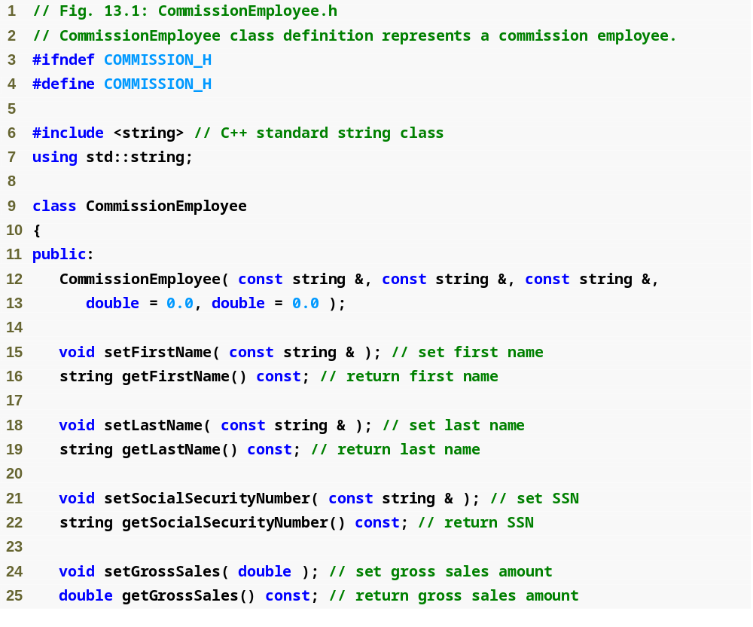
Example 1
Commission
Employee.h
(1 of 2)

Slide 13
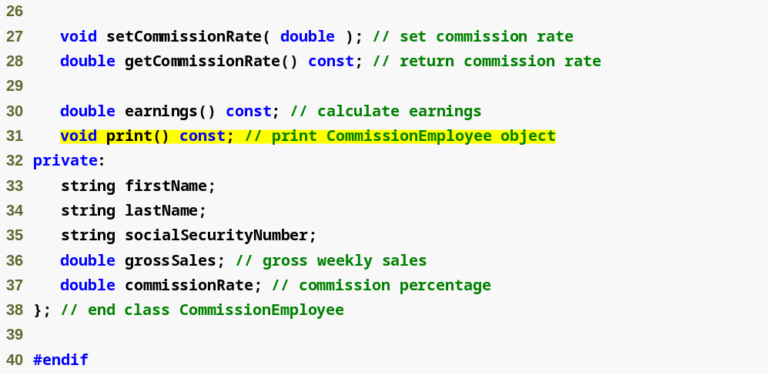
Function earnings will be redefined in derived classes to calculate the employee’s earnings
Function print will be redefined in derived class to print the employee’s information
Example 1
Commission
Employee.h
(2 of 2)

Slide 14
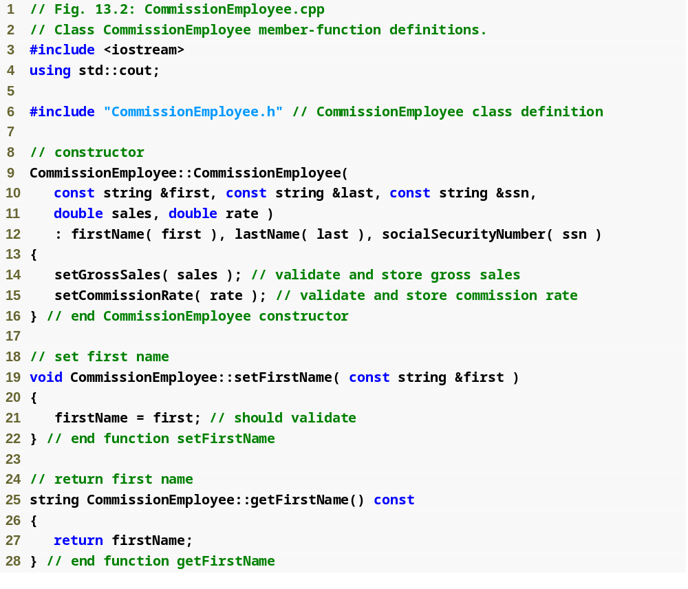
Example 1
Commission
Employee.cpp
(1 of 4)

Slide 15
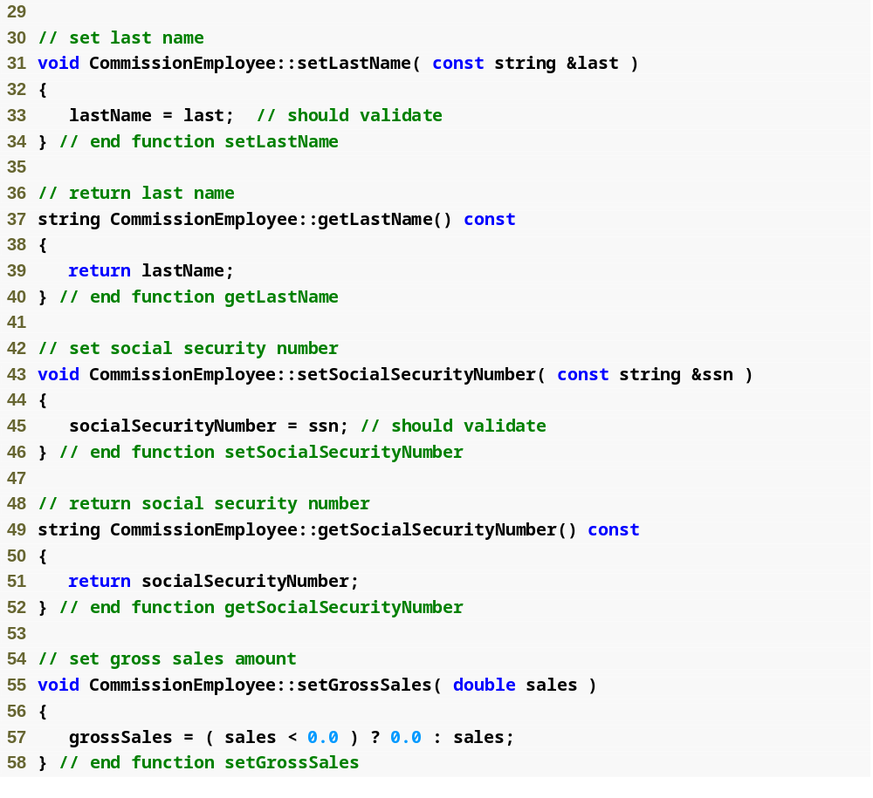
Example 1
Commission
Employee.cpp
(2 of 4)

Slide 16
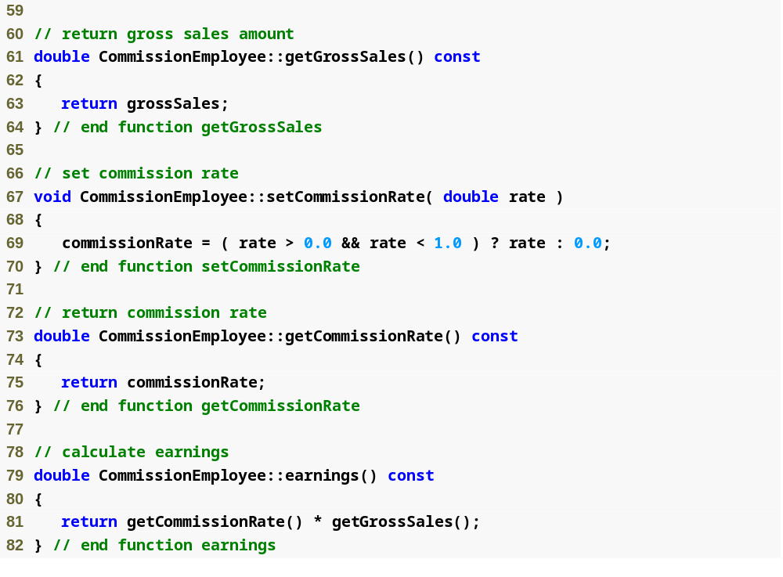
Example 1
Commission
Employee.cpp
(3 of 4)
Calculate earnings based on commission rate and gross sales

Slide 17
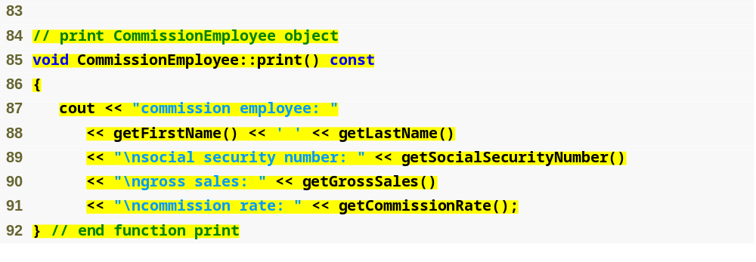
Example 1
Commission
Employee.cpp
(4 of 4)
Display name, social security number, gross sales and commission rate

Slide 18
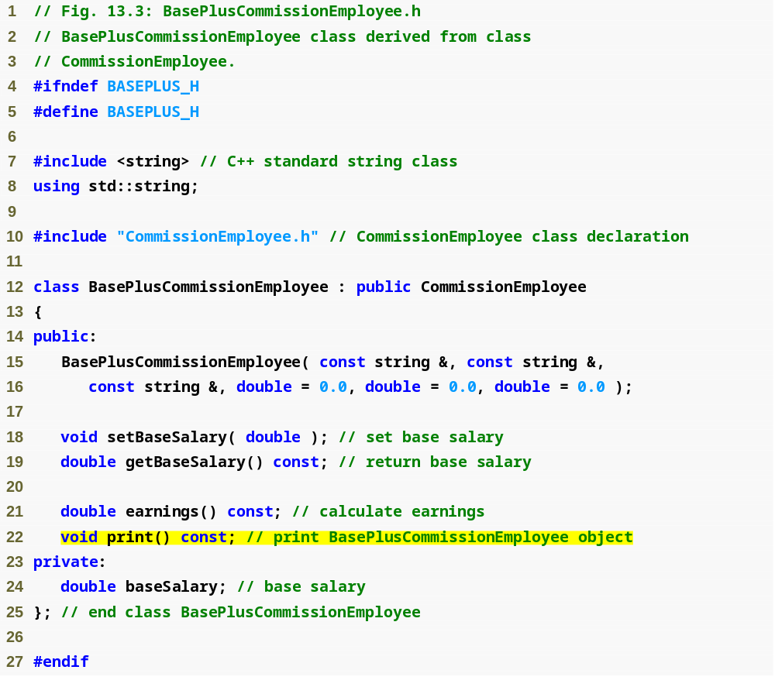
Example 1
BasePlus
Commission
Employee.h
(1 of 1)
Redefine functions earnings and print

Slide 19
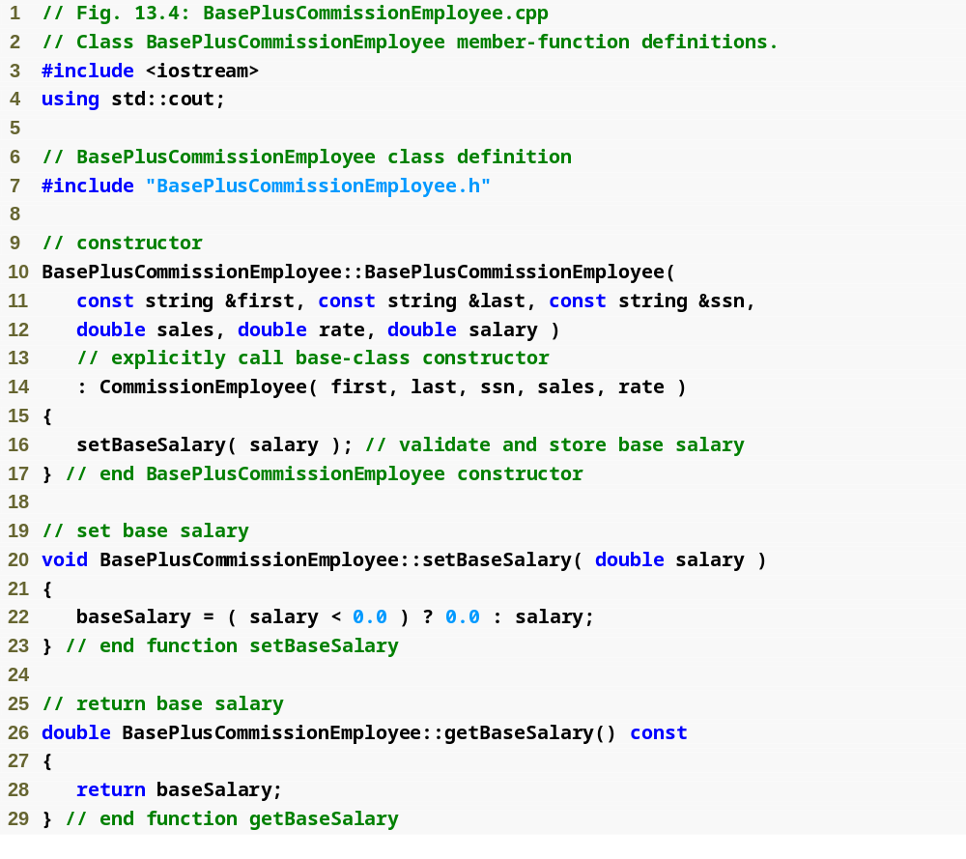
Example 1
BasePlus
Commission
Employee.cpp
(1 of 2)

Slide 20
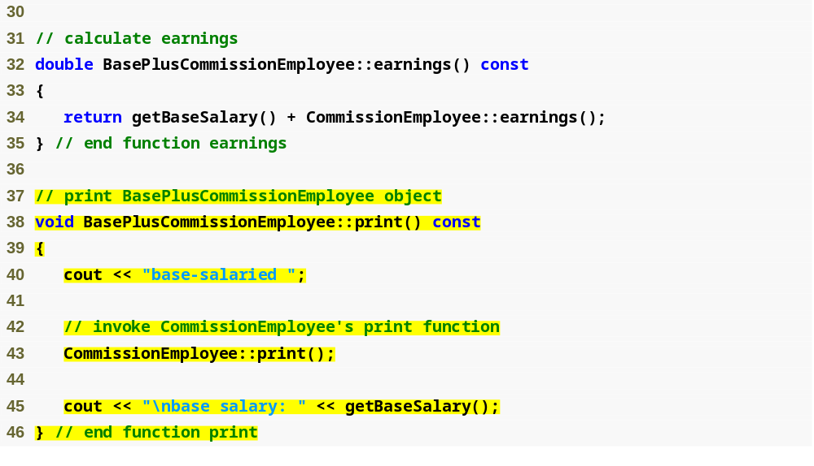
Redefined earnings function incorporates base salary
Redefined print function displays additional BasePlusCommissionEmployee details
Example 1
BasePlus
Commission
Employee.cpp
(2 of 2)

Slide 21
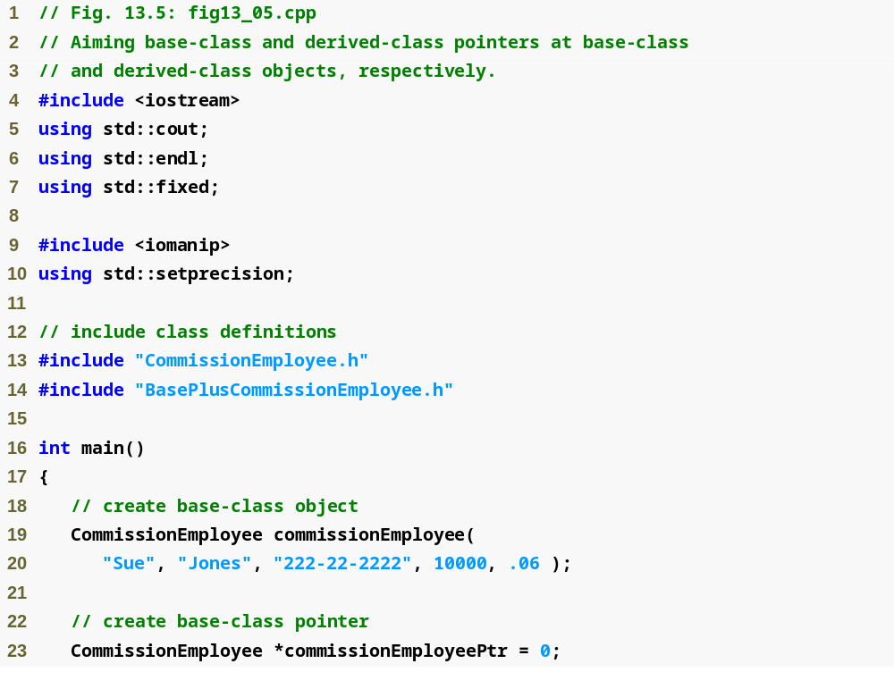
Example 1
pointersBaseDer1.cpp
(1 of 3)

Slide 22
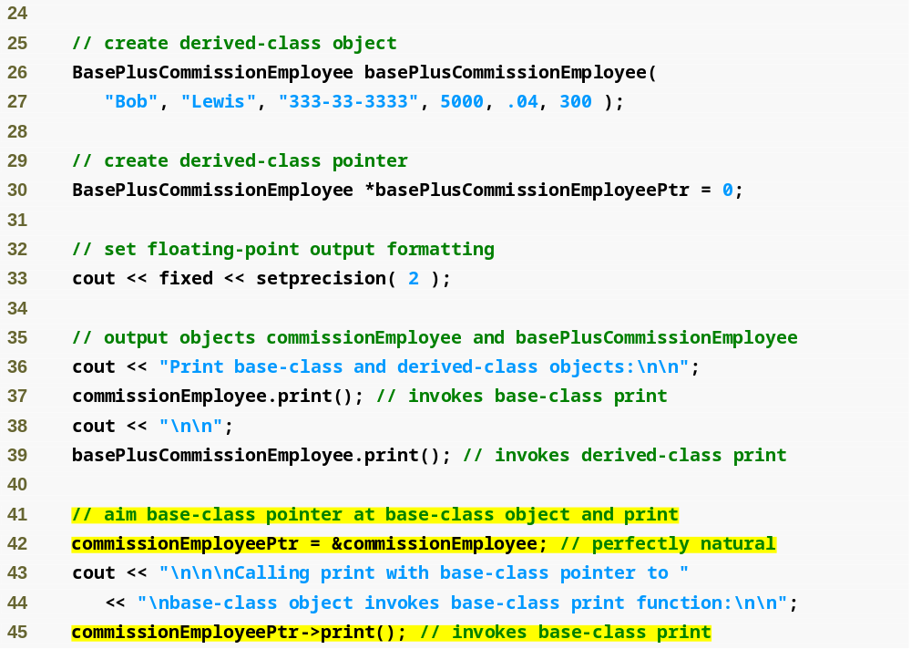
Example 1
pointersBaseDer1.cpp
(2 of 3)
Aiming base-class pointer at base-class object and invoking base-class functionality

Slide 23
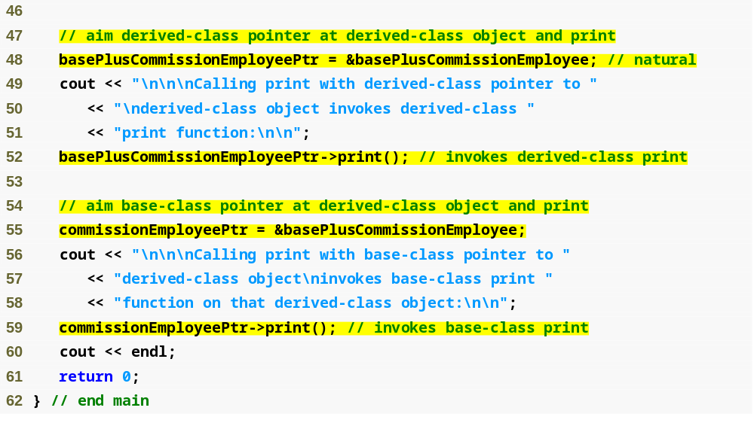
Aiming derived-class pointer at derived-class object and invoking derived-class functionality
Aiming base-class pointer at derived-class object and invoking base-class functionality
The output of each print member function
invoked in this program reveals that the functionality
invoked depends on the type of the HANDLE (the pointer
or reference type) used to invoke (call) the function NOT
the type of the object to which the handle points
--This is NOT polymorphic
What we're going to see in a minute is we can use virtual
functions to invoke the functionality based on the object type
rather than on the handle type
--This is crucial to implementing polymorphism
Example 1
pointersBaseDer1.cpp
(3 of 3)

Slide 24
Example #2: Inheritance Hierarchy Relationships
In our last example we assigned the address of a derived-class object to a base-class pointer
  This was allowed because a derived class object is a base class object
  The opposite is NOT true, a base class object is NOT a derived class object
Example #2 attempts to:
Aim a derived-class pointer at a base-class object
  C++ compiler generates error
    CommissionEmployee (base-class object) is NOT a BasePlusCommissionEmployee (derived-class object)
  If this were to be allowed, programmer could then attempt to access derived-class members which do not exist
    Through a BasePlusCommissionEmployee pointer we can invoke every BasePlusCommissionEmployee member function, including the setBaseSalary() function for the object to which the pointer points (which is a CommssionEmployee rather than a BasePlusCommissionEmployee)
    The CommissionEmployee does not have a baseSalary data member to set and does not have a setBaseSalary function
    This would lead to problems because the setBaseSalary function would assume there is a baseSalary data member to set and would attempt to set it
      Could modify memory being used for other data

Slide 25
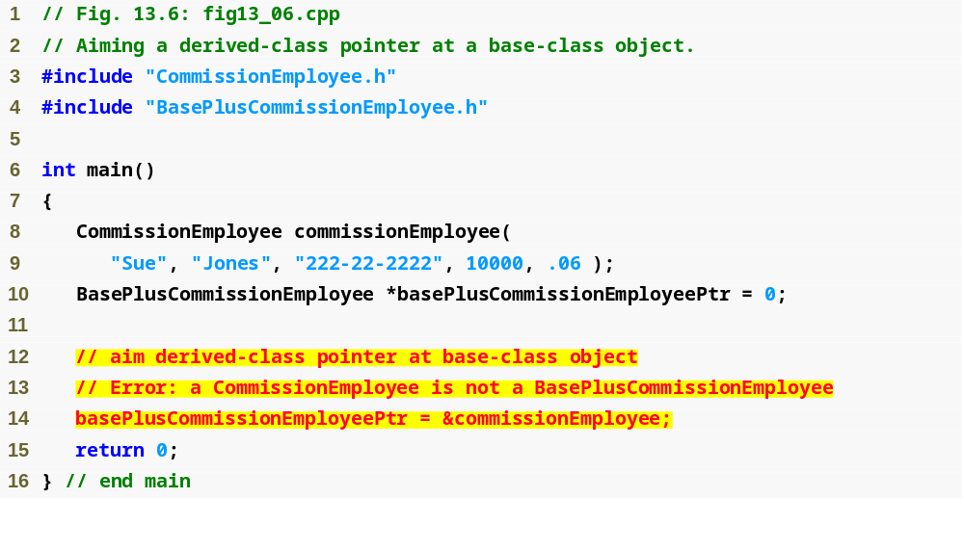
Example 2
Cannot assign base-class object to derived-class pointer because is-a relationship does not apply

Slide 26
Example #3: Inheritance Hierarchy Relationships
When we're using a base class pointer, the compiler ONLY allows us to invoke BASE class member functions (this would include base class member functions that are re-defined in derived classes, just not functions specific to derived classes)
  If a base class pointer points at a derived class object and attempts to access a derived class function (that is not one that is redefined from the base class) a compilation error will occur
Example #3 attempts to:
  call a derived class function with a base class pointer pointing to a derived class object
    A compilation error occurs
The compiler does allow access to derived-class objects from a base class pointer pointing to a derived class object if:
  we explicitly cast the base-class pointer to a derived-class pointer
    This is called downcasting
    I added an example of the downcast in the Visual C++ Example 3 code, uncomment it to see it work

Slide 27
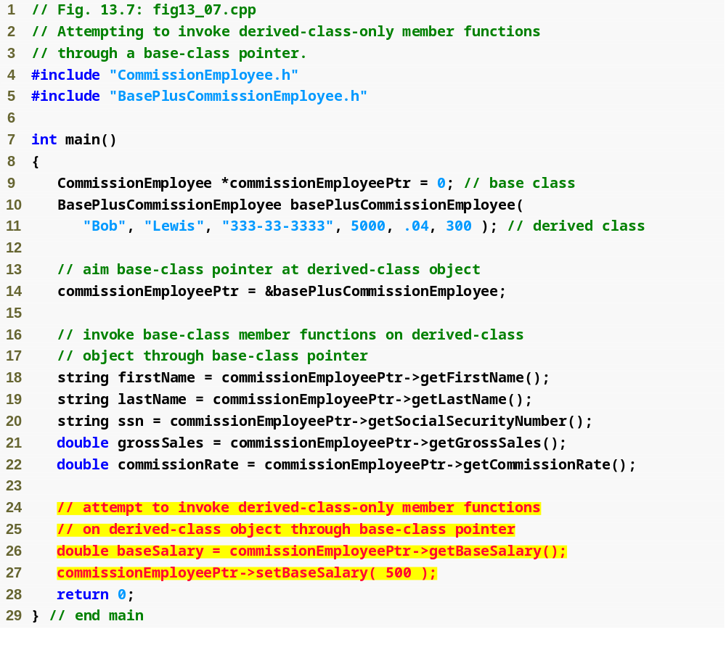
Example 3
Cannot invoke derived-class-only members from base-class pointer

Slide 28
Virtual Functions
Virtual functions allow the most specific version of a member function in an inheritance hierarchy to be selected for execution.
  Virtual functions are what makes polymorphism possible
  With virtual functions we're going to be able to tell the compiler not to automatically select the base version of a function (when using an array or container of pointers to a base class) but instead to select the more specialized version of a function given a choice
    This means if a derived class supplies its own version of the virtual function, the compiler will execute the specialized version of the class resulting in polymorphic behavior
Which class’s function is invoked using a pointer to an object:
  Normally
    Handle (the pointer or reference) determines which class’s functionality to invoke
  With virtual functions
    The type of the object being pointed to, not type of the handle, determines which version of a virtual function to invoke
    Allows program to dynamically (at runtime rather than compile time) determine which function to use
      Called dynamic binding or late binding
This slide contains KEY CONCEPTS you must know, this is the key to object oriented programming (and thus GUI and game programming as well)

Slide 29
Virtual Functions
Example of why virtual functions are useful
  Suppose that there is a base-class Shape
    Derived from shape are the classes: Circle, Triangle, Rectangle and Square
    Each of these classes has a draw() function to draw themselves with
      The draw() function for each class is quite different even though it has the same name for each class and does the same generic activity
  Now say you want your program to be able to draw a set of shapes all at once but you don't know what shapes
    To allow our program to draw any Shape we can simple use an array of base-class Shape pointers to invoke the function draw() based on the type of object which the base-class Shape pointer points to at any one time
  To make this work we will have to declare the draw() function in the base-class to be a virtual function
    Then we override draw() in each of the derived classes to draw the appropriate shape
Override vs. Redefine
  Two types of functions we are talking about now, know the difference
  An overridden function has the same signature and return type as the function it overrides (redefines) in the base class
    The function it overrides in the base class is virtual and enables polymorphic behavior
  A redefined function also has the same signature as the function it redefines in the base class
    The function it redefines is NOT virtual and therefore does not enable polymorphic behavior
Make sure you know the difference between an overridden function
And a redefined function

Slide 30
Virtual Functions
To declare a virtual function precede the function's name with the keyword virtual in the base class
  Example: virtual void draw() const;
    virtual functions do NOT have to be const, this one is just because a draw function would not usually change the Shape on which it was invoked
virtual functions
  Declared by preceding the function’s prototype with the keyword virtual in base class
  Derived classes then override the function as appropriate
  Once declared virtual, a function remains virtual all the way down the hierarchy
    So the one declaration of virtual makes it so anytime this function is called on any object down the hierarchy from the class it is declared virtual in:
      it invokes the object's specific (overridden) version of the function if there is one rather than the base class function

Slide 31
Virtual Functions
Once a function is declared virtual, it remains virtual all the way down the inheritance hierarchy from that point on even if that function is not explicitly declared virtual when a class overrides it.
  TIP: Even though certain functions are implicitly virtual because of a declaration made higher in the class hierarchy:
    you SHOULD explicitly declare these functions virtual at every level of the hierarchy to promote program clarity.
When a programmer browses a class hierarchy to locate a class to reuse, it is possible that a function in that class will exhibit virtual function behavior even though it is not explicitly declared virtual.
  This happens when the class inherits a virtual function from its base class, and it can lead to subtle logic errors.
  Such errors can be avoided by explicitly declaring all virtual functions virtual throughout the inheritance hierarchy.
  Basically it's saying that even though virtual "status" propagates down the inheritance hierarchy it is good practice to still explicitly declare all the functions virtual

Slide 32
Virtual Functions
When a derived class chooses not to override a virtual function from its base class, the derived class simply inherits its base class’s virtual function implementation.

Slide 33
static vs. dynamic binding
If a program invokes a virtual function through a base-class pointer to a derived class object like so: shapePtr->draw()
  the program will choose the correct derived-class function dynamically (at execution (run) time) based on the OBJECT TYPE, NOT on the handle (pointer or reference) type
Dynamic binding: choosing the appropriate function to call at execution (run) time (rather than at compile time)
  IMPORTANT: Dynamic binding occurs only off pointer and reference handles
If a program invokes (calls) a virtual function by referencing a specific object and using the dot operator like so: squareObject.draw()
  the program will resolve the function choice at compile time and NOT at run time and the virtual function that is called is the one defined for (or inherited by) the class of that particular object
    This is NOT polymorphic
  This is called static binding: choosing the appropriate function to call at compile time
Know the difference between dynamic binding and static binding

Slide 34
Example 4: virtual Functions
Now we're going to redo our previous examples by making the print() and earnings() functions virtual in CommissionEmployee
  This means our print() and earnings() functions in BasePlusCommissionEmployee override (rather than redefine) these virtual functions
    Even those these inherit the virtual property we will declare them virtual to make the code more readable and avoid potential errors
Now when we create our CommissionEmployee pointer and have it point to a BasePlusCommissionEmployee object:
  and call the print() or earnings() function, the most specific version of the function will be called which is the one in the BasePlusCommissionEmployee class
Note we only need to make the virtual declaration in the specification (.h) files, no changes needed to be made to the implementation files

Slide 35
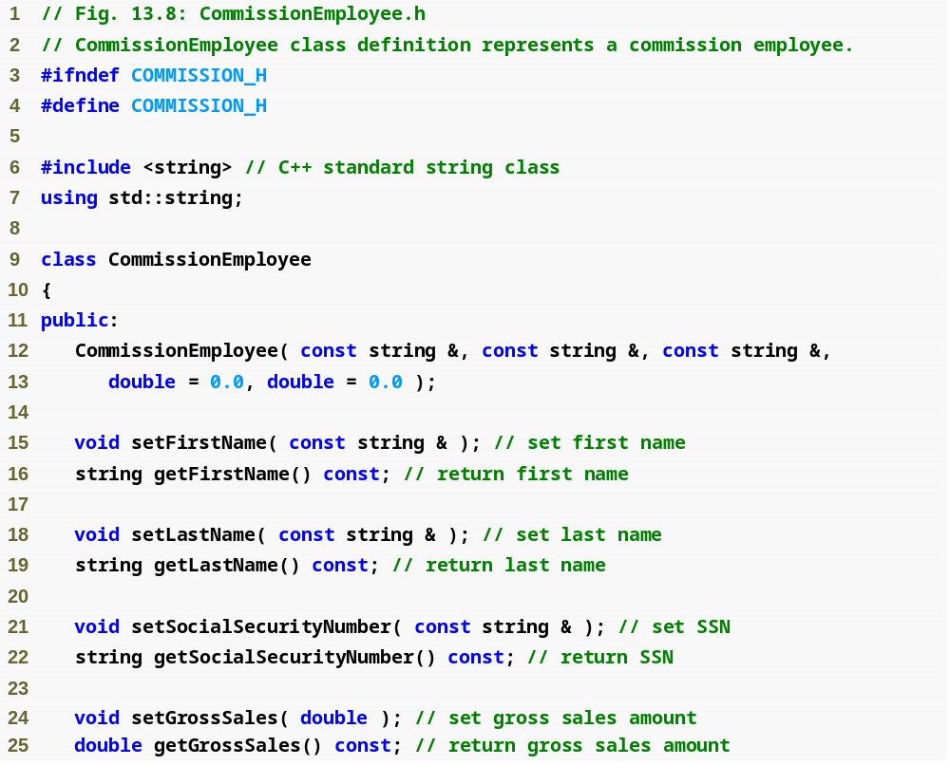
Example 4
Commission
Employee.h
(1 of 2)

Slide 36
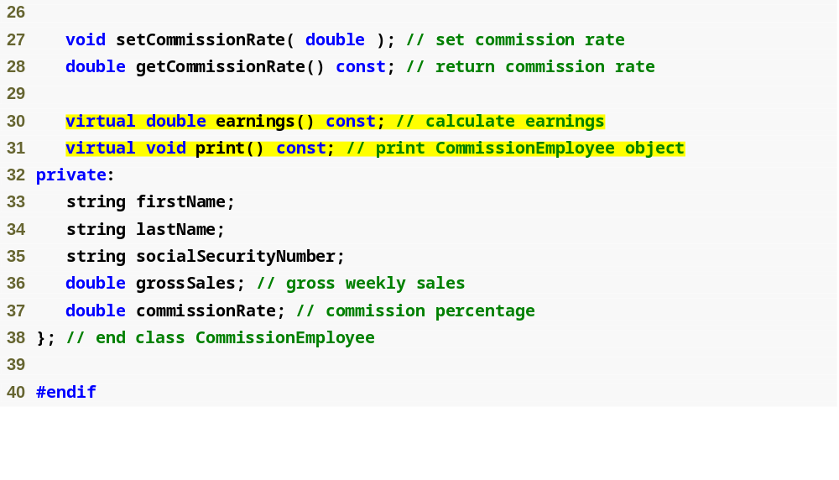
Declaring earnings and print as virtual allows them to be overridden, not redefined
Example 4
Commission
Employee.h
(2 of 2)

Slide 37
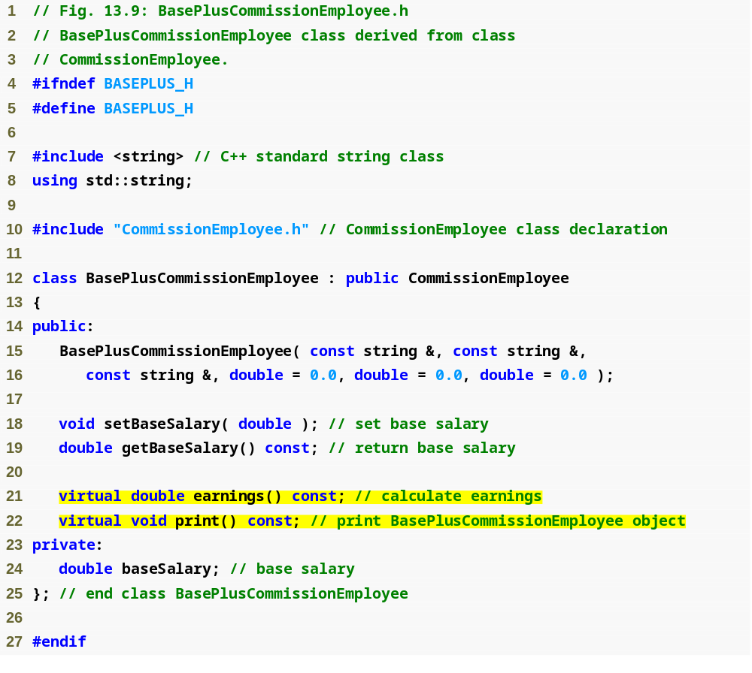
Example 4
BasePlus
Commission
Employee.h
(1 of 1)
Functions earnings and print are already virtual – good practice to declare virtual even when overriding function
We are now overriding instead of
redefining these functions

Slide 38
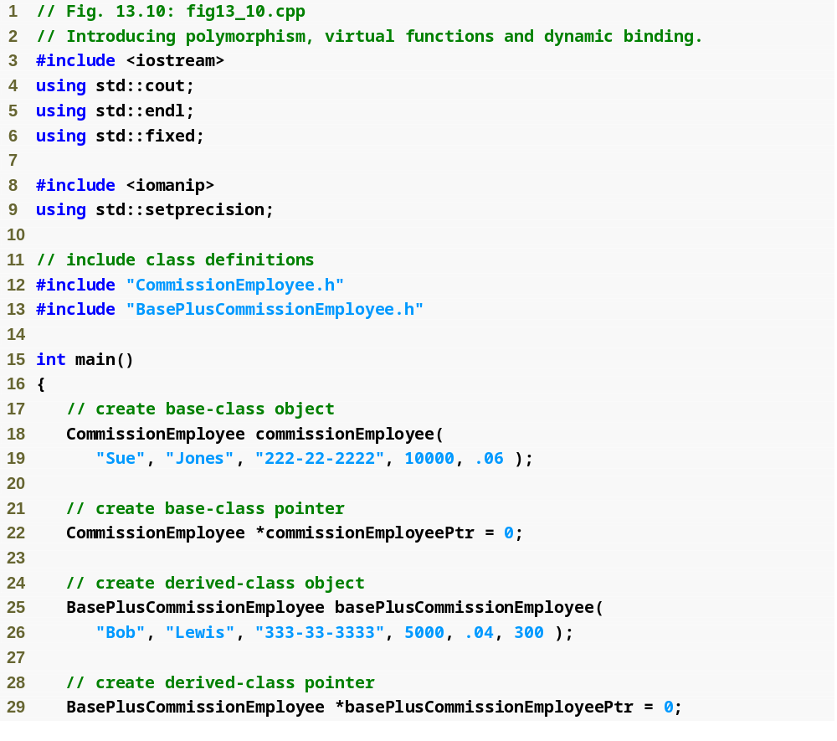
Example 4
virtualExample.cpp
(1 of 3)

Slide 39
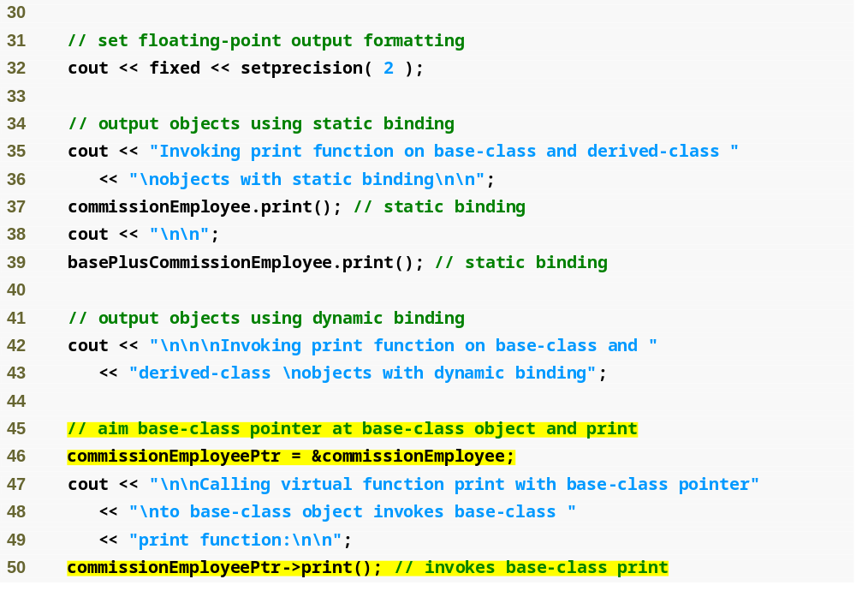
Example 4
virtualExample.cpp
(2 of 3)
Aiming base-class pointer at base-class object and invoking base-class functionality

Slide 40
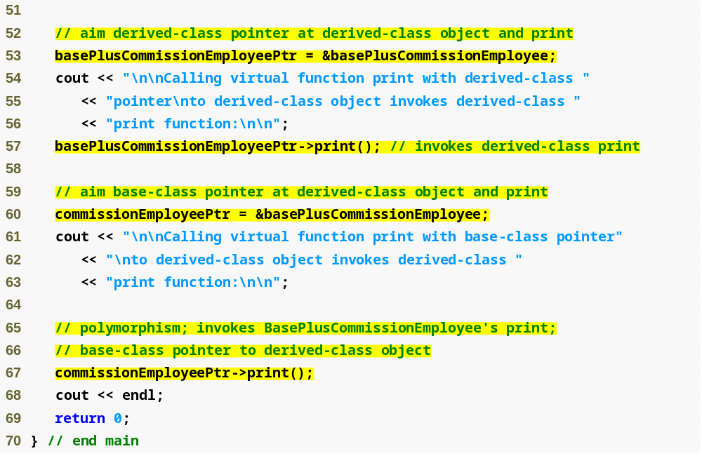
Aiming derived-class pointer at derived-class object and invoking derived-class functionality
Example 4
virtualExample.cpp
(3 of 3)
Aiming base-class pointer at derived-class object and invoking derived-class functionality via polymorphism and virtual functions

Slide 41
Allowed Assignments Between Base-Class and Derived-Class Objects and Pointers
Four ways to aim base-class and derived-class pointers at base-class and derived-class objects
  Aiming a base-class pointer at a base-class object
    Is straightforward
  Aiming a derived-class pointer at a derived-class object
    Is straightforward
  Aiming a base-class pointer at a derived-class object
    Is safe, but can be used to invoke only member functions that base-class declares (unless downcasting is used)
    Can achieve polymorphism with virtual functions
  Aiming a derived-class pointer at a base-class object
    Generates a compilation error

Slide 42
Abstract Classes
Sometimes you may want to define a class that you never intend to instantiate any objects from
  Such a class is called an abstract class
Abstract classes
  Classes from which the programmer never intends to instantiate any objects
  These classes are normally used as base classes in inheritance hierarchies
    due to this they are also called abstract base classes
  These classes can NOT be used to instantiate objects because:
    abstract classes are incomplete—derived classes must define the “missing pieces”
    abstract classes are too generic to define real objects
The purpose of an abstract class is to:
  Provide an appropriate base class from which other classes can inherit
Classes that ARE used to instantiate objects are called concrete classes
  So this is the opposite of an abstract class
  Concrete classes
    must provide implementation for every member function they define
Often abstract classes will be in the top level or top few levels of an inheritance hierarchy
Abstract base classes are too generic to define real objects
  Imagine the TwoDimensionalShape base class with the derived classes of Circle and Square
    How could you tell someone to draw a TwoDimensionalShape?
    The concrete classes provide the specifics for things like this
Need to know the difference between an abstract class and a concrete class

Slide 43
Abstract Classes and pure virtual Functions
A class is made abstract by declaring one or more of its virtual functions to be "pure"
A pure virtual function is made by
  Placing “= 0” in its declaration
    Example
      virtual void draw() const = 0;
    “= 0” is known as a pure specifier
Pure Virtual Functions
  Do not provide implementations
    Every concrete derived class of an abstract base class must override all base-class pure virtual functions with concrete implementations
      If not overridden, the derived-class will also be abstract (meaning you won’t be able to instantiate objects from the base class)
Difference between a virtual function and a pure virtual function
  A virtual function HAS an implementation and the derived class has the OPTION of overriding the function
  A pure virtual function does NOT HAVE an implementation and the derived class is REQUIRED to override, if not the derived class is also abstract
Pure virtual functions are used when:
  it does not make sense for base class to have an implementation of a function, but the programmer wants all concrete derived classes to implement the function
Need to know the difference between a virtual function and a pure virtual function

Slide 44
Software Engineering Observations
An abstract class defines a common public interface for the various classes in a class hierarchy.
  An abstract class contains one or more pure virtual functions that concrete derived classes must override.
An abstract class has at least one pure virtual function.
  An abstract class also can have data members and concrete functions (including constructors and destructors), which are subject to the normal rules of inheritance by derived classes.
Common Errors:
  Attempting to instantiate an object of an abstract class causes a compilation error.
  Failure to override a pure virtual function in a derived class, then attempting to instantiate objects of that class, is a compilation error.
    Remember if you don't override a pure virtual function in a derived class then the derived class is also abstract

Slide 45
Example 5: Payroll System with Polymorphism
Enhanced CommissionEmployee-BasePlusCommissionEmployee hierarchy using an abstract base class
  Abstract class Employee represents the general concept of an employee
    Declares the “interface” to the hierarchy
    Each employee has a first name, last name and social security number
  Earnings calculated differently and objects printed differently for each derived class – so these functions must be overridden
Problem Statement:
  A company pays its employees weekly
  There are four types of employees
    Salaried Employees are paid a fixed weekly salary regardless of the number of hours worked
    Hourly Employees are paid by the hour and receive overtime pay for hours worked in excess of 40 hours per week
    Commission Employees are the same as before
    Base Commission Employees have been rewarded by adding 10% to their base salaries
  The company wants to implement a program that performs its payroll calculations polymorphically

Slide 46
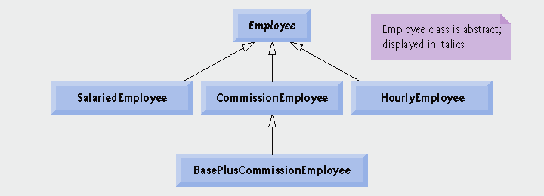
Example 5: Payroll System with Polymorphism
Class hierarchy

Slide 47
Example 5: Abstract Base Class Employee
Class Employee
  Provides various get and set functions
    Inheritance rules we discussed still apply, we're just adding polymorphism
  Provides functions earnings() and print()
    Function earnings() depends on type of employee, so declared pure virtual
      Not enough information in class Employee for a default implementation
    Function print() is virtual, but not pure virtual
      Default implementation provided in Employee
Example maintains an array of Employee pointers
  Polymorphically invokes proper earnings and print functions

Slide 48
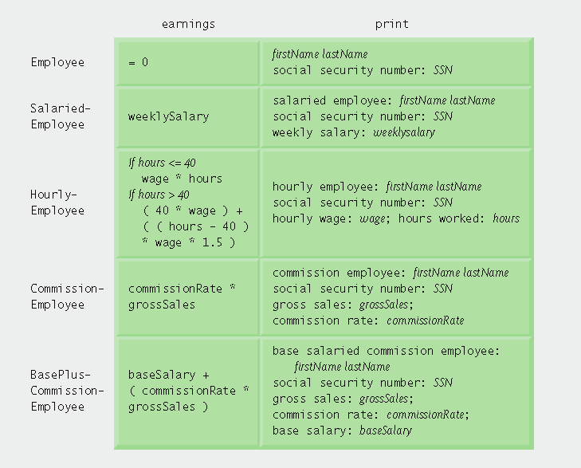
Example 5: Polymorphic Interface

Slide 49
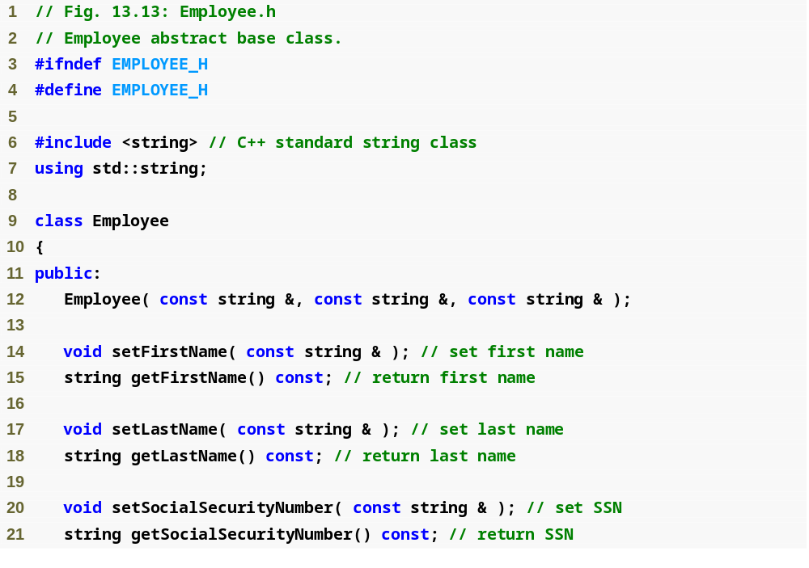
Example 5
Employee.h
(1 of 2)

Slide 50
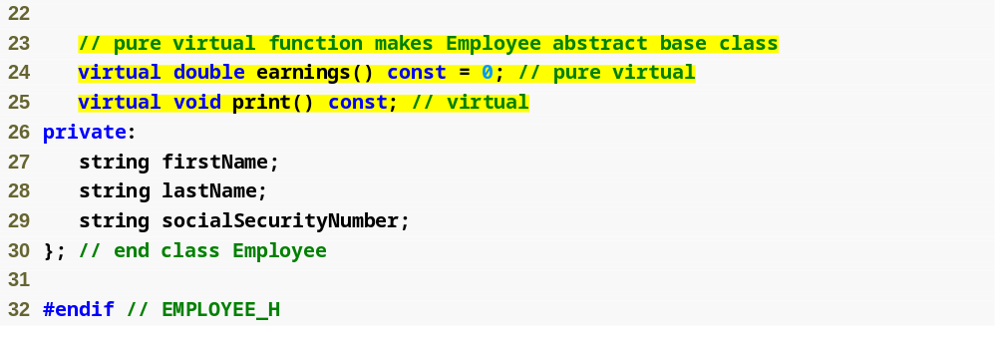
Function earnings is pure virtual, not enough data to provide a default, concrete implementation
Function print is virtual, default implementation provided but derived-classes may override
Example 5
Employee.h
(2 of 2)

Slide 51
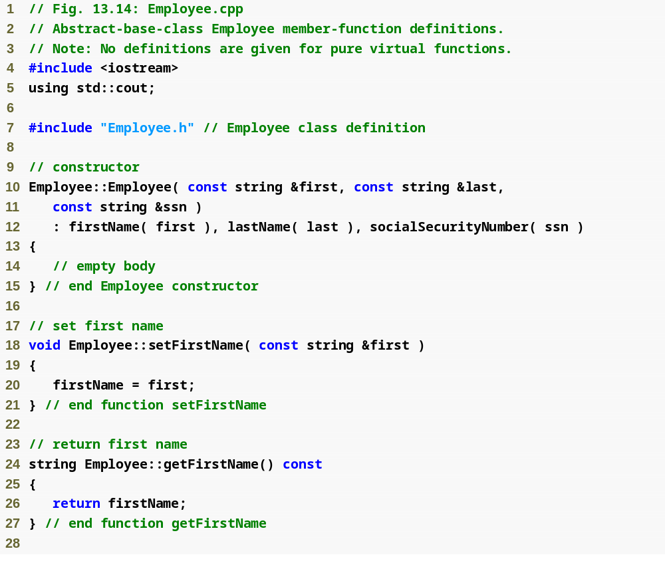
Example 5
Employee.cpp
(1 of 2)

Slide 52
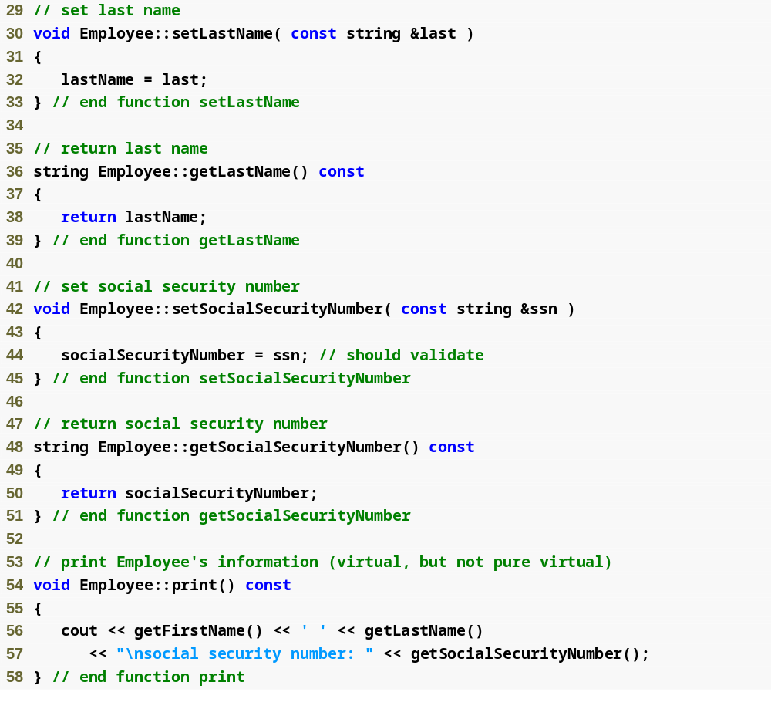
Example 5
Employee.cpp
(2 of 2)

Slide 53
Example 5: Concrete Derived Class SalariedEmployee
SalariedEmployee inherits from Employee
  Includes a weekly salary
    Overridden earnings function incorporates weekly salary
      Required override since pure virtual
    Overridden print function incorporates weekly salary
  Is a concrete class (implements all pure virtual functions from abstract base class)

Slide 54
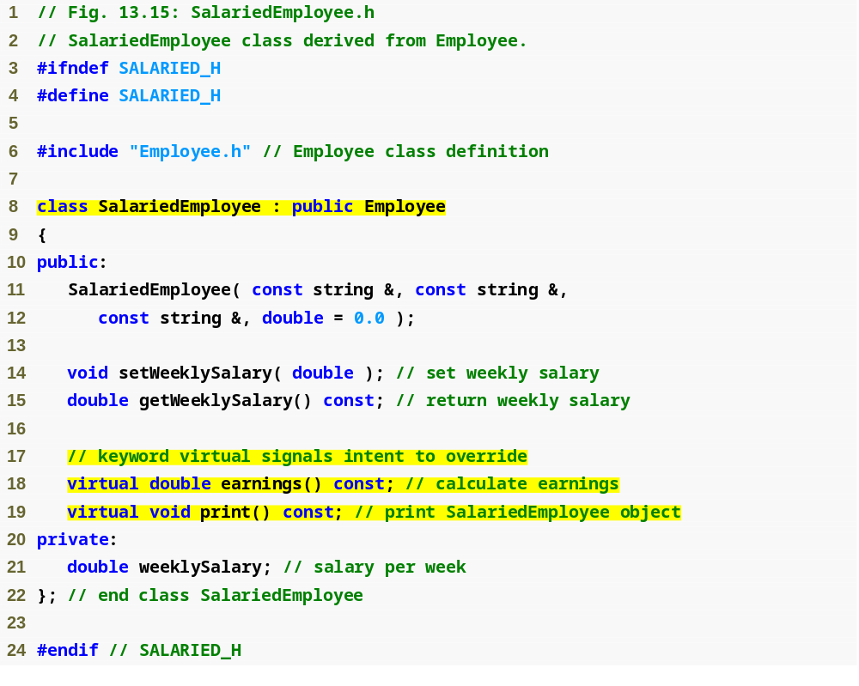
SalariedEmployee inherits from Employee, must override earnings to be concrete
Example 5
Salaried
Employee.h
(1 of 1)
Functions will be overridden (or defined for the first time)

Slide 55
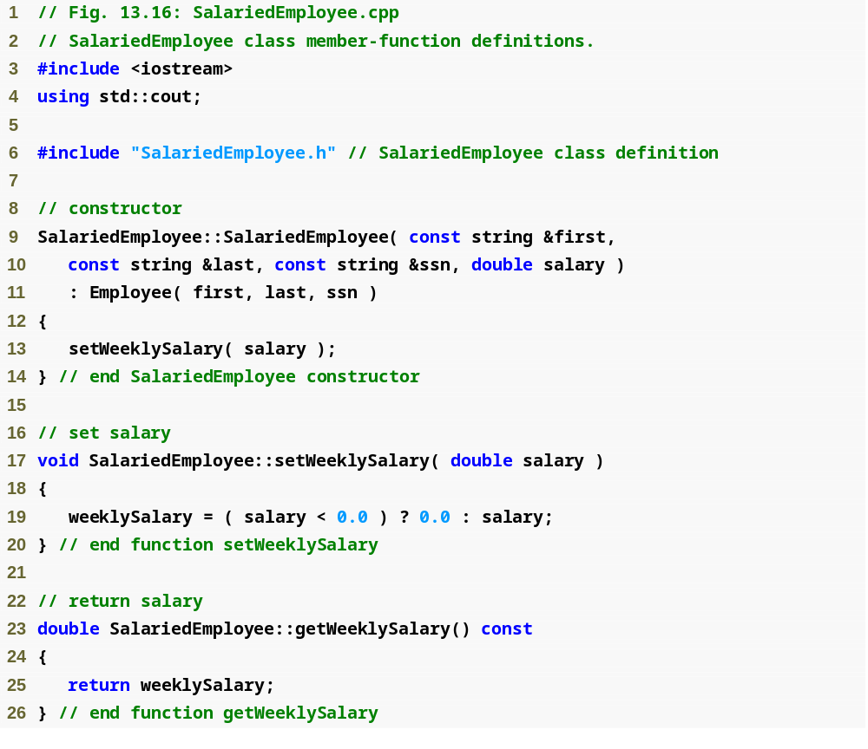
Example 5
Salaried
Employee.cpp
(1 of 2)
Maintain new data member weeklySalary

Slide 56
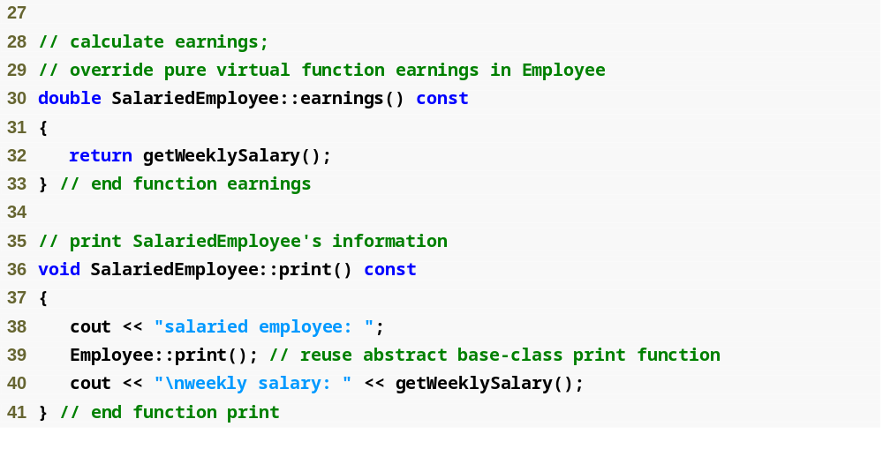
Overridden earnings and print functions incorporate weekly salary
Example 5
Salaried
Employee.cpp
(1 of 2)

Slide 57
Example 5: Concrete Derived Class HourlyEmployee
HourlyEmployee inherits from Employee
  Includes a wage and hours worked
    Overridden earnings function incorporates the employee’s wages multiplied by hours (taking time-and-a-half pay into account)
      Required to be overridden since pure virtual
    Overridden print function incorporates wage and hours worked
  Is a concrete class (implements all pure virtual functions in abstract base class)

Slide 58
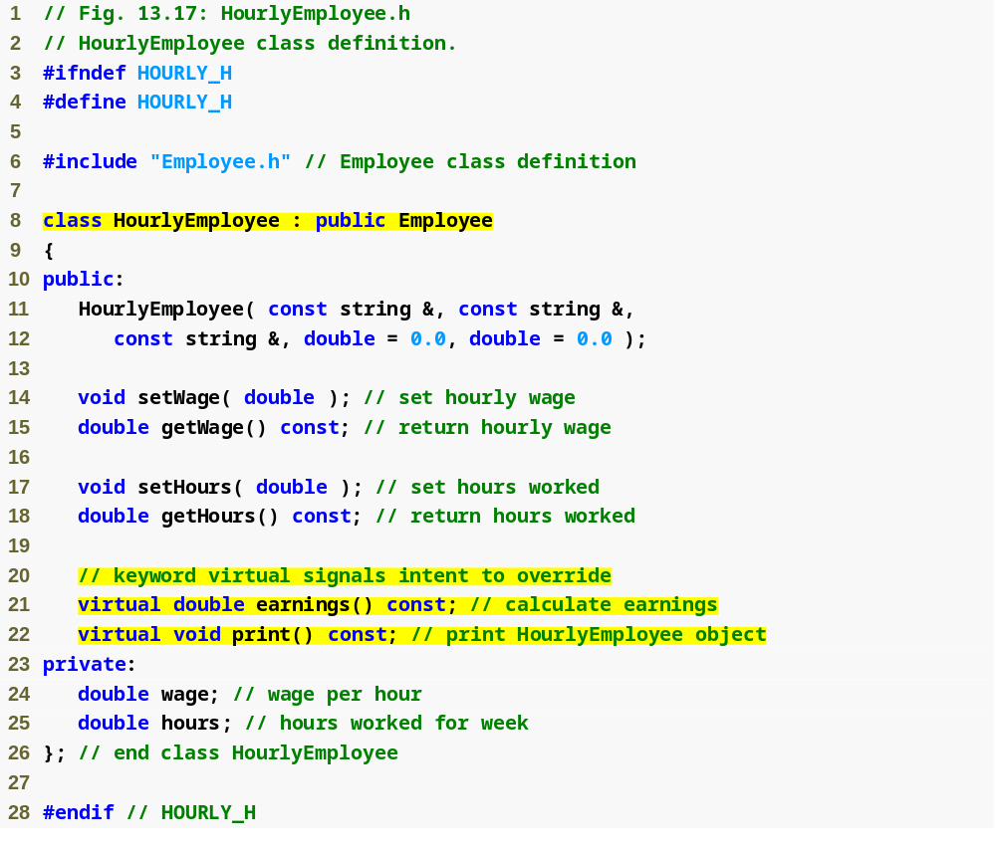
HourlyEmployee inherits from Employee, must override earnings to be concrete
Example 5
Hourly
Employee.h
(1 of 1)
Functions will be overridden (or defined for first time)

Slide 59
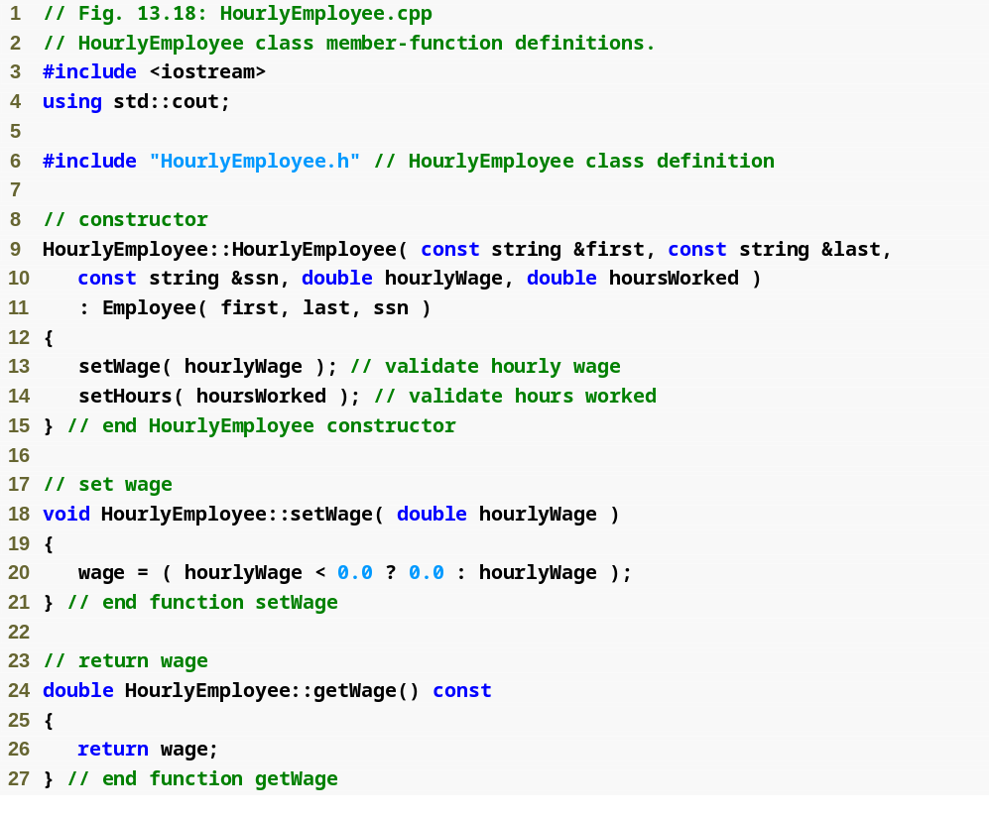
Example 5
Hourly
Employee.cpp
(1 of 2)
Maintain new data member, hourlyWage

Slide 60
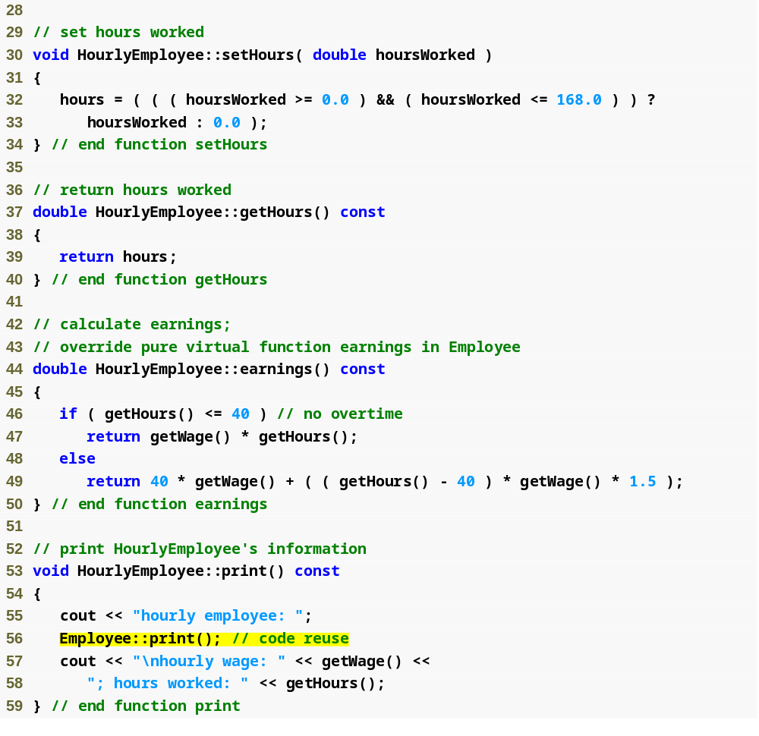
Maintain new data member, hoursWorked
Example 5
Hourly
Employee.cpp
(2 of 2)
Overridden earnings and print functions incorporate wage and hours

Slide 61
Example 5: Concrete Derived Class CommissionEmployee
CommissionEmployee inherits from Employee
  Includes gross sales and commission rate
    Overridden earnings function incorporates gross sales and commission rate
    Overridden print function incorporates gross sales and commission rate
  Concrete class (implements all pure virtual functions in abstract base class)

Slide 62
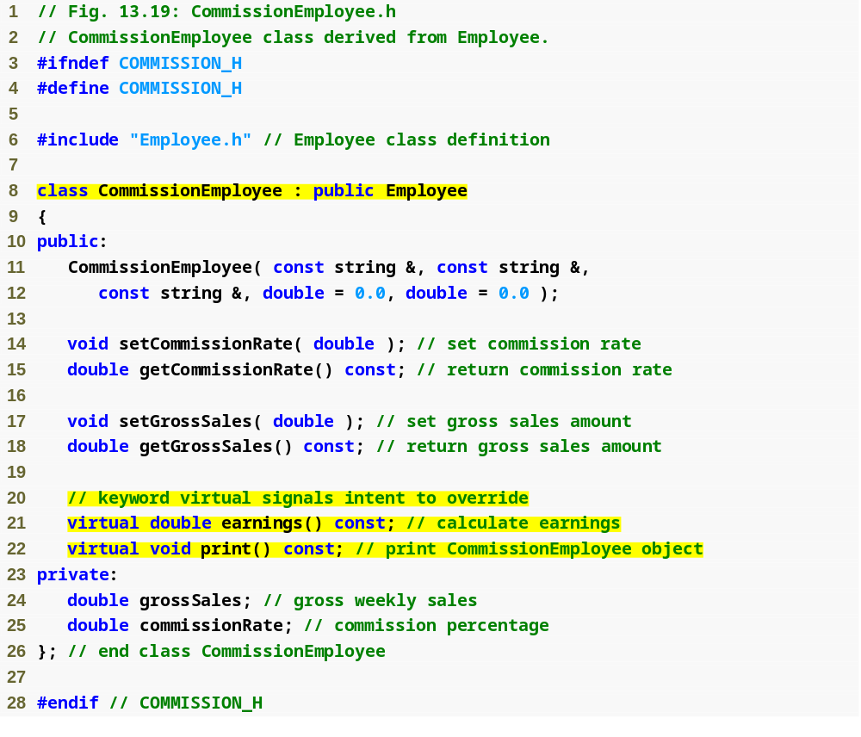
CommissionEmployee inherits from Employee, must override earnings to be concrete
Example 5
Commission
Employee.h
(1 of 1)
Functions will be overridden (or defined for first time)

Slide 63
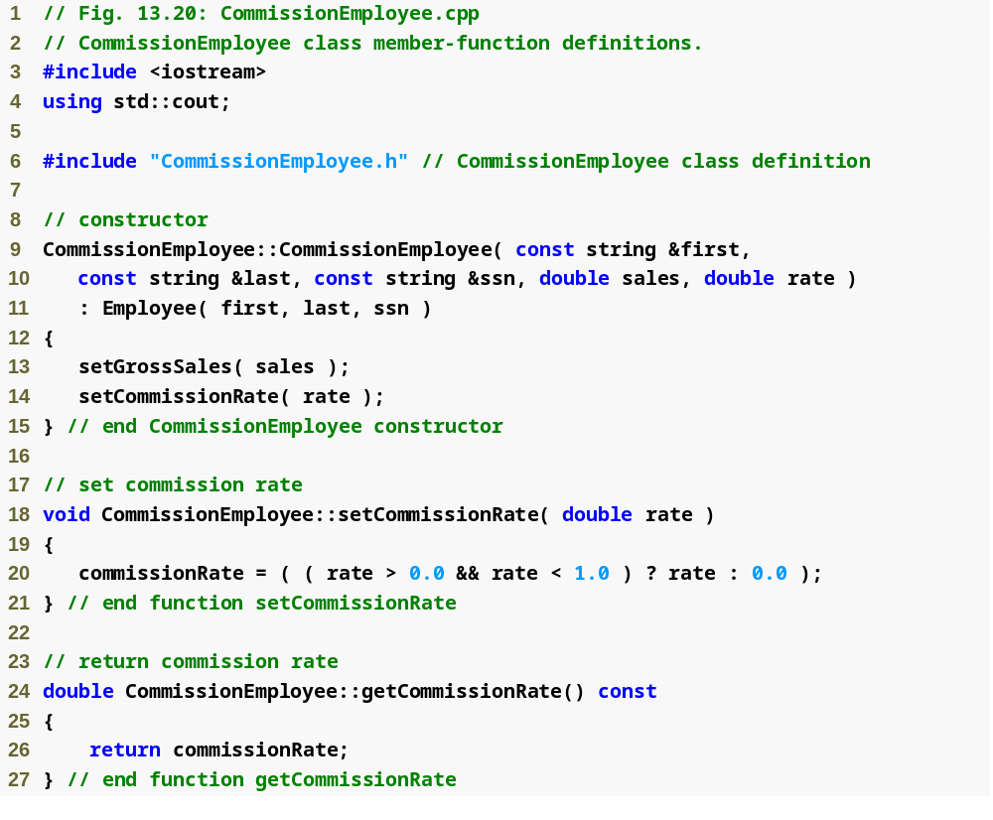
Example 5
Commission
Employee.cpp
(1 of 2)
Maintain new data member, commissionRate

Slide 64
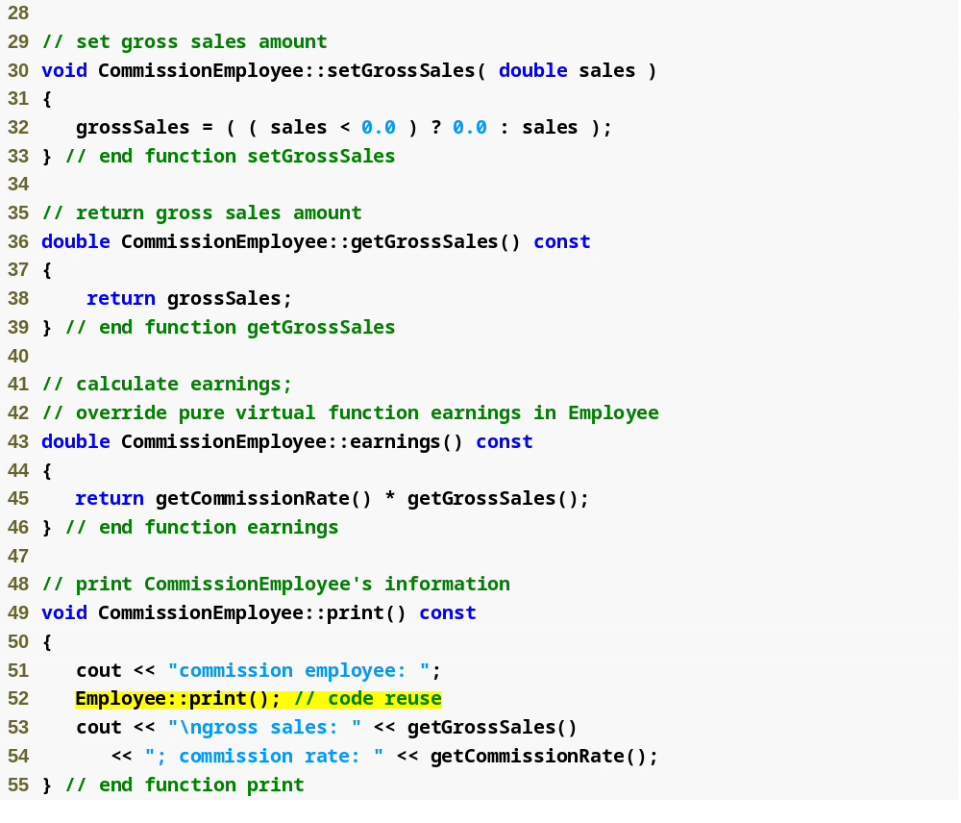
Maintain new data member, grossSales
Example 5
Commission
Employee.cpp
(2 of 2)
Overridden earnings and print functions incorporate commission rate and gross sales

Slide 65
Example 5: Concrete Derived Class BasePlusCommissionEmployee
BasePlusCommissionEmployee inherits from CommissionEmployee
  Includes base salary
    Overridden earnings function that incorporates base salary
    Overridden print function that incorporates base salary
  Concrete class, because derived class is concrete
    Not necessary to override earnings to make it concrete, can inherit implementation from CommissionEmployee
      Although we do override earnings to incorporate base salary

Slide 66
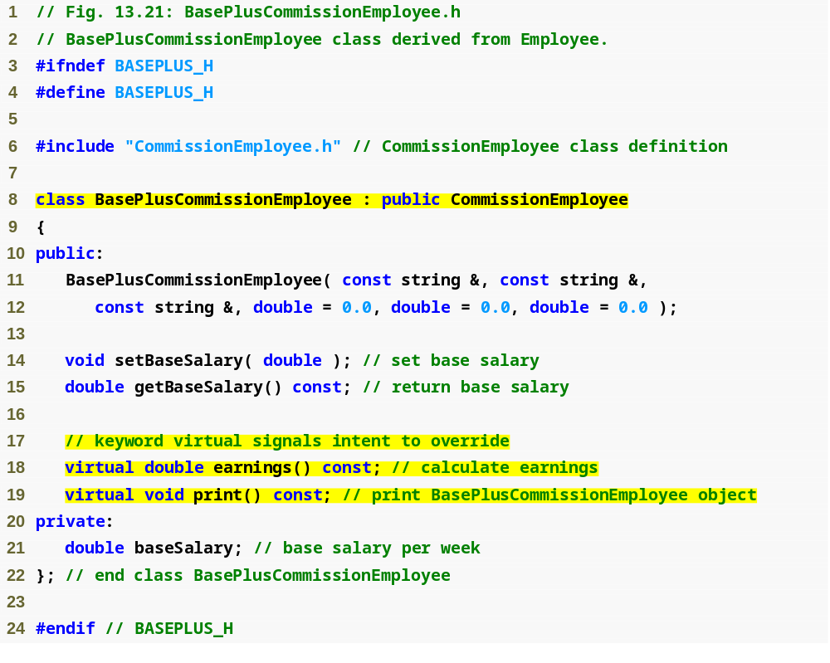
BasePlusCommissionEmployee inherits from CommissionEmployee, already concrete
Example 5
BasePlus
Commission
Employee.h
(1 of 1)
Functions will be overridden

Slide 67
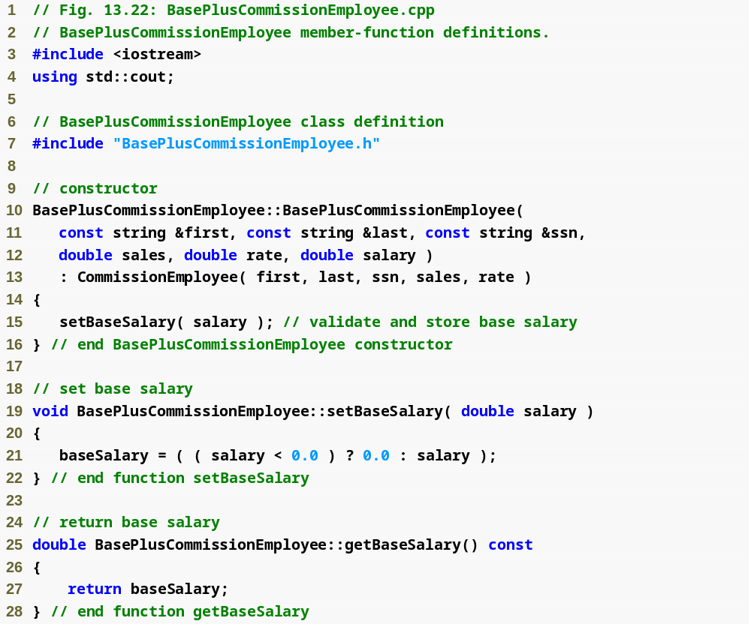
Example 5
BasePlus
Commission
Employee.cpp
(1 of 2)
Maintain new data member, baseSalary

Slide 68
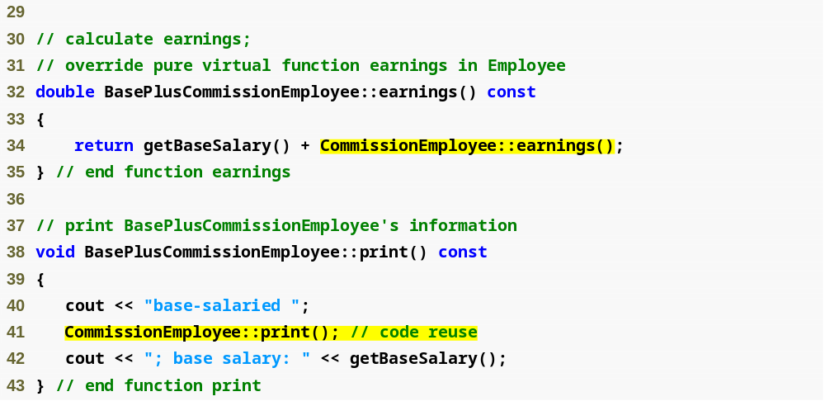
Overridden earnings and print functions incorporate base salary
Example 5
BasePlus
Commission
Employee.cpp
(2 of 2)

Slide 69
Example 5: Demonstrate Polymorphism
Create objects of types SalariedEmployee, HourlyEmployee, CommissionEmployee and BasePlusCommissionEmployee
  Demonstrate manipulating objects with static binding
    Using name handles rather than pointers or references
    Compiler can identify each object’s type to determine which print and earnings functions to call
  Demonstrate manipulating objects polymorphically
    Uses a array of Employee pointers
      I changed this to array from what is in the book
    Invoke virtual functions using pointers and references

Slide 70
#include <iostream>
#include <stdlib.h>
#include <iomanip>
using namespace std;
#include "Employee.h"
#include "SalariedEmployee.h"
#include "HourlyEmployee.h"
#include "CommissionEmployee.h"
#include "BasePlusCommissionEmployee.h"
int main()
{
cout << fixed << setprecision(2);
SalariedEmployee salEmp("John", "Smith", "111-11-1111", 800);
HourlyEmployee hourEmp("Karen", "Price", "222-22-2222", 16.75, 40);
CommissionEmployee commEmp("Sue", "Jones", "333-33-3333", 10000, .06);
BasePlusCommissionEmployee baseCommEmp("Bob", "Lewis", "444-44-4444", 5000, .04, 300);
const int SIZE = 4;
salEmp.print();
cout << "\nEarned $" << salEmp.earnings() << "\n\n";
hourEmp.print();
cout << "\nEarned $" << hourEmp.earnings() << "\n\n";
commEmp.print();
cout << "\nEarned $" << commEmp.earnings() << "\n\n";
baseCommEmp.print();
cout << "\nEarned $" << baseCommEmp.earnings() << "\n\n";
Employee* employees[SIZE];
employees[0] = &salEmp;
employees[1] = &hourEmp;
employees[2] = &commEmp;
employees[3] = &baseCommEmp;
cout << "Employees processed POLYMORPHICALLY via DYNAMIC BINDING:\n\n";
for(int i = 0; i < SIZE; i++){
employees[i]->print();
cout << "\nEarned $" << employees[i]->earnings() << "\n\n";
}
system("PAUSE");
return 0;
}
Example 5
payrollTest.cpp

